Slide 1
Early Detection of Alzheimer's Disease
1

Slide 2

TEAM MEMBERS
Devansh Prashar(2110993775)
Ishita Jindal(2110993799)

Slide 3

INDEX
Introduction
Objective
Related work
Implemented model
Results
Comparison

Slide 4

INTRODUCTION
In the entire world, Alzheimer's disease (AD) is the most frequent cause of dementia.
A progressive neurologic condition reduces brain size (brain atrophy) and kills brain cells, resulting in a slow deterioration of thinking, acting, and social skills that reduces a person's capacity for independence.

Slide 5
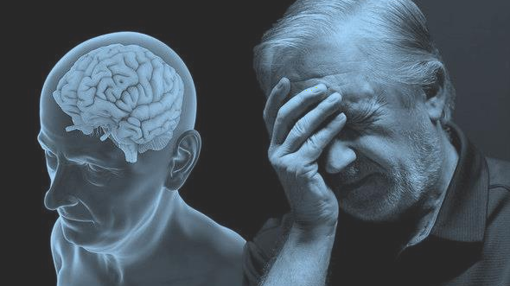
INTRODUCTION
5.8 million people age 65 and older live with Alzheimer's disease (AD), which is difficult and incurable if it progresses to an advanced level. Eighty percent of them are 75 or older.
Out of the estimated 50 million persons with dementia worldwide

Slide 6


OBJECTIVE
An early Alzheimer's diagnosis provides patients with a better chance of benefiting from treatment and that motivates us to make this study which used deep learning to classify Alzheimer's illness into multiple categories.
6

Slide 7
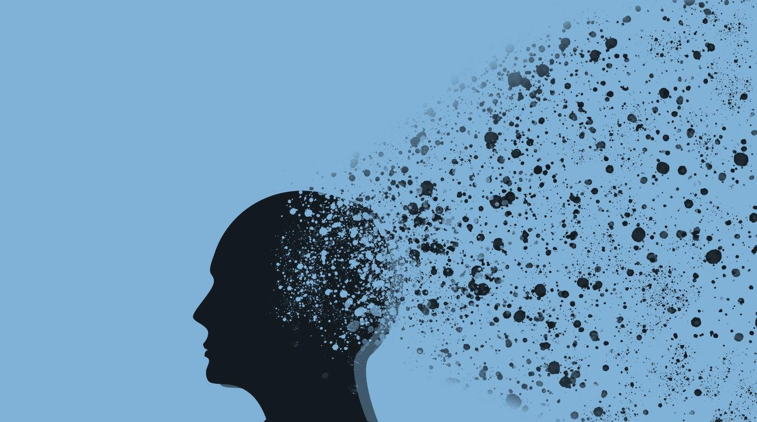




IMPLEMENTED MODEL DIAGRAM
ADNI Dataset
Image Preprocessing
Data Augmentation
(Zoom , Rotation , flipping , Switching)
CNN Classifier
(Densnet121 , VGG19 , SqueezeNet)
`
Trained model predict output
Prediction

Slide 8
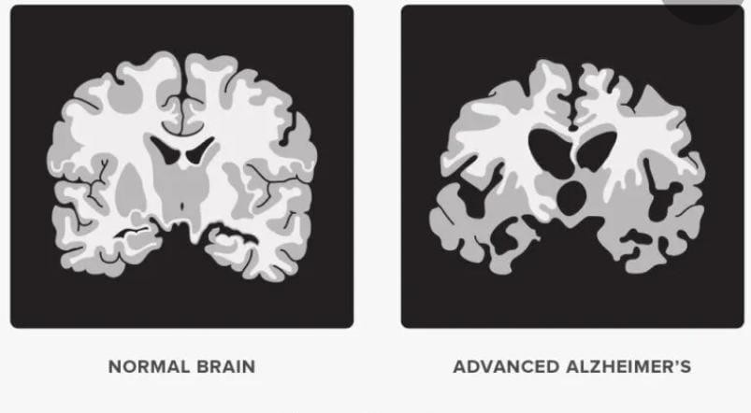
Comparison Between Normal Brain & Advanced Alzheimer’s .

Slide 9

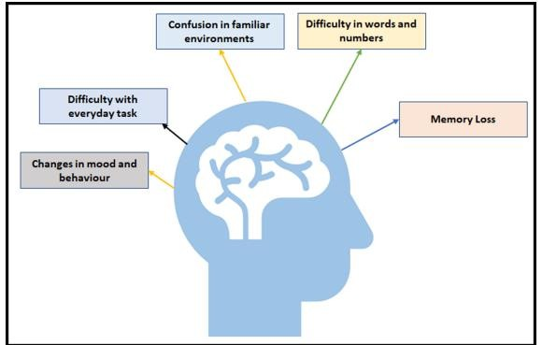
Symptoms of Alzheimer's Disease
9

Slide 10
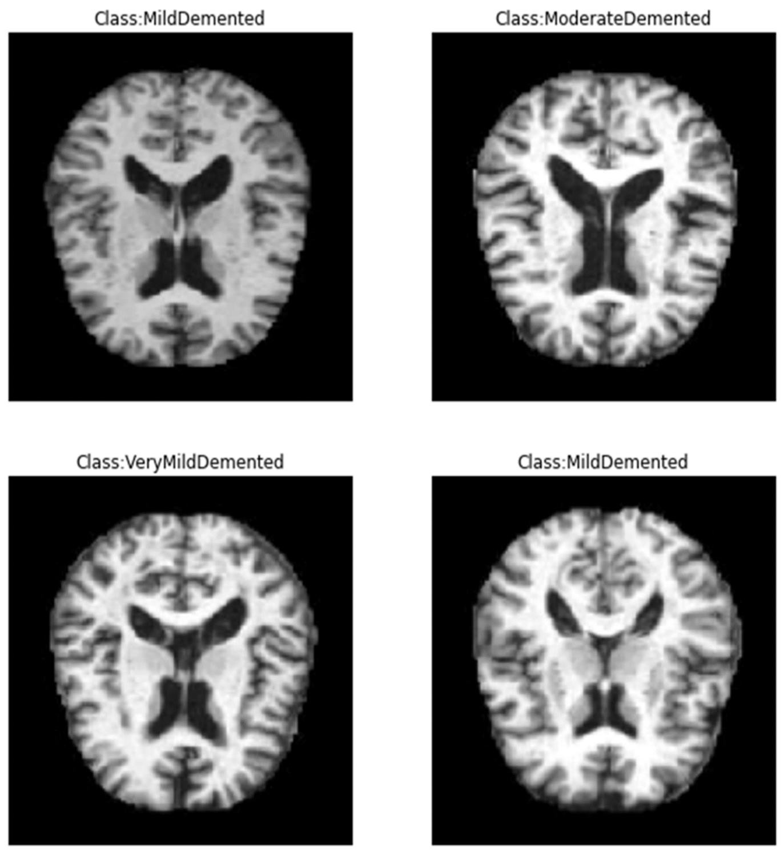
Class:NonDemented
Comparison Between Different classes of infected brain in MRI.
10

Slide 11
Dataset
ADNI
Original size for Alzheimer MRI (224,224).
The Dataset is consisting of Preprocessed MRI (Magnetic Resonance Imaging) .
The Dataset has four classes of images.

Slide 12
Dataset
The Dataset is consisting of total (6400) MRI images.
Class - 1: Mild Demented (896 images)
Class - 2: Moderate Demented (64 images)
Class - 3: Non-Demented (3200 images)
Class - 4: Very Mild Demented (2240 images)

Slide 13

Image Preprocessing
We applied Data Augmentations techniques such as zoom, rotation , flipping ,switching.
The factor parameter for rotation is between -0.15
,0.15.
The factor parameter for zoom is between -0.3 , -0.1.

Slide 14
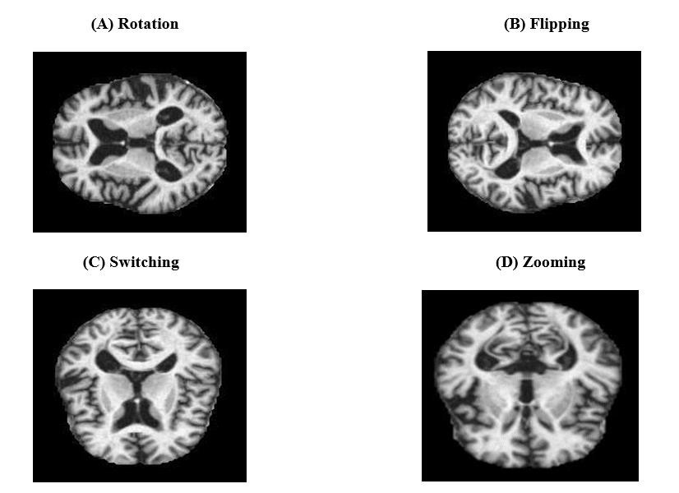
Image Preprocessing
14

Slide 15

Applied Dataset
All the images are resized into 128 x 128 pixels.
The dataset after data augmentation consists of total (33,984) MRI images.
Class - 1: Mild Demented (8960 images).
Class - 2: Moderate Demented (6464 images).
Class - 3: Non-Demented (9600 images).
Class - 4: Very Mild Demented (8960 images).
15

Slide 16
RELATED WORK
Paper | Author | Algorithm& Accuracy
Early Detection of Alzheimer’s Disease Using Non-invasive Near- Infrared Spectroscopy.(2019) | Khan (OASIS) | Adaboosting: 88.73% Artificial Neural Network:83.04%
Deep Learning Model for Prediction of Progressive Mild Cognitive Impairment to Alzheimer’s Disease Using Structural MRI.(2022) | Bing Yan Lim (ADNI) | CNN:72.7% VGG16:80.66% RESNET:76.86%
Deep Learning Approach for Early Detection of Alzheimer’s Disease. (2021) | Hadeer Helaly (ADNI) | CNN:93.61% Vgg19:97%
Deep Convolutional Neural Network based Classification of Alzheimer’s Disease using MRI Data.(2021) | Ali Nawaz (OASIS , ADNI) | Deep CNN:73.75% GLCM:79.90%
Development and validation of an interpretable deep learning framework for Alzheimer’s disease classification.(2020) | Shangran Qiu (ADNI, AIBL, NACC) | FCN-MLP WITH CNN:0.968 +/- 0.014 16

Slide 17
RELATED WORK
Paper | Author | Algorithm& Accuracy
Detecting Alzheimer’s disease using machine learning methods.(2021) | Kia Dashtipour | BILSTEM:93.19%
Transfer learning using freeze features for Alzheimer neurological disorder detection using ADNI dataset.(2021) | Saeeda Naz1 (ADNI) | VGG16:99.14% VGG19:95.89%
MRI Segmentation and Classification of Human Brain Using Deep Learning for Diagnosis of Alzheimer’s Disease: A Survey.(2020) | Yamanakkanvar (ADNI, AIBL, IBSR) | 94.3%(CSF) DSC/JI:97.5%(WM) 94.8%(GM)
Early-Stage Alzheimer’s Disease Prediction Using Machine Learning Models.(2022) | C. Kavitha (OASIS) | XGBOOST:85.92%
DEMNET: A Deep Learning Model for Early Diagnosis of Alzheimer Diseases and Dementia From MR Images.(2021) | Suriya Murugan (ADNI) | transfer learning:98.7% 3DCNN:97.52% 3DVIEW MODEL:95.11%

Slide 18
CNN Classifier
VGG19, DenseNet121, and SqueezeNet
were the deep learning models we used.

Slide 19
1-DenseNet121
Parameter | Value | Reason
Input shape | 128*128*3 | Classification of image size.
Optimization Function | Adam | Most used optimizer in the literature.
Bath Size | 16 | After several trials we found that small batch sizes give better results.
Epochs | 30 | The maximum number we were able to reach while doing our test, without google colab blocking us .
Output Shape | Probability vector with 3 elements | /

Slide 20
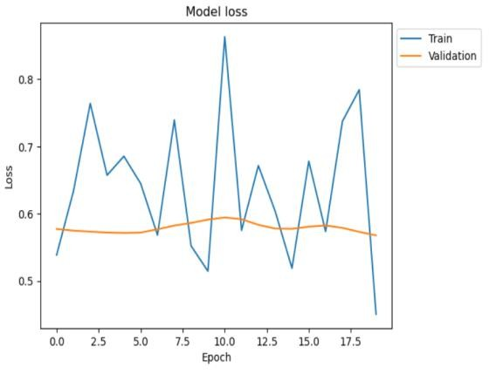
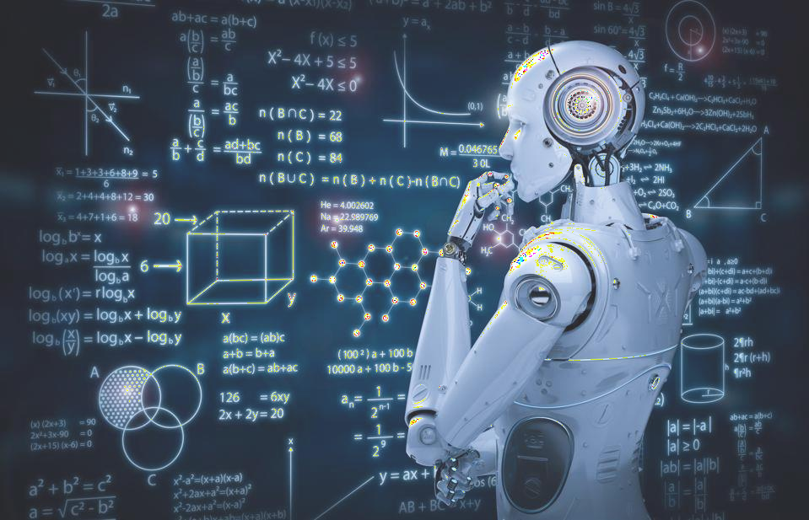
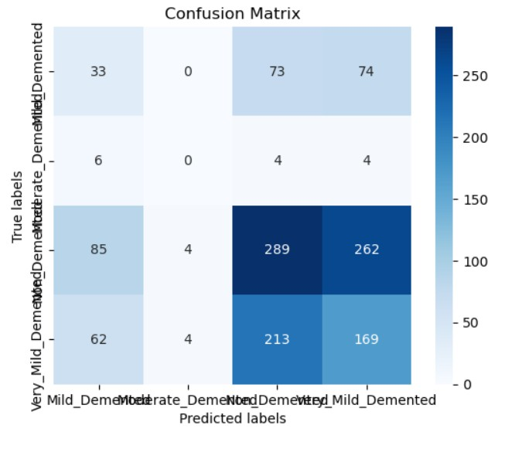
Training and Validation Loss in DenseNet121& confusion matrix

Slide 21

2-VGG19
Parameter | Value | Reason
Input shape | 128*128*3 | Classification of image size.
Optimization Function | Adam | Most used optimizer in the literature.
Bath Size | 32 | After several trials we found that small batch sizes give better results.
Epochs | 50 | The maximum number we were able to reach while doing our test, without google colab blocking us .
Output Shape | Probability vector with 3 elements | /

Slide 22

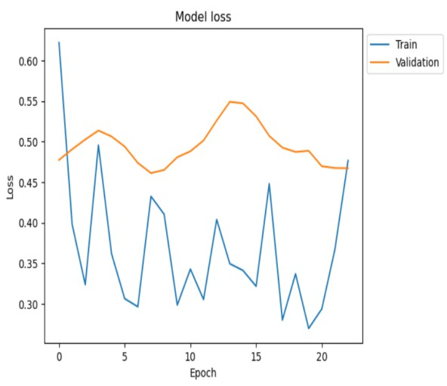
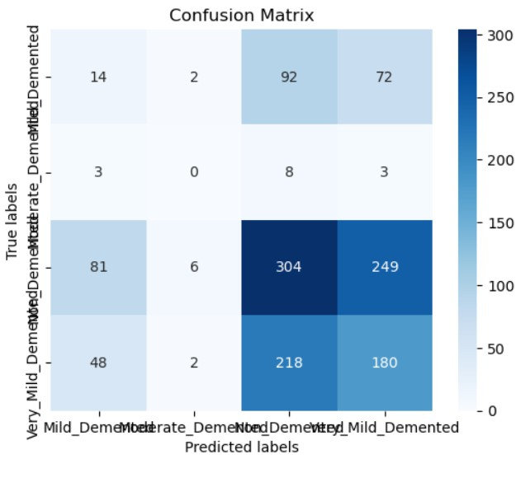
Training and Validation Loss in VGG19 & confusion matrix

Slide 23
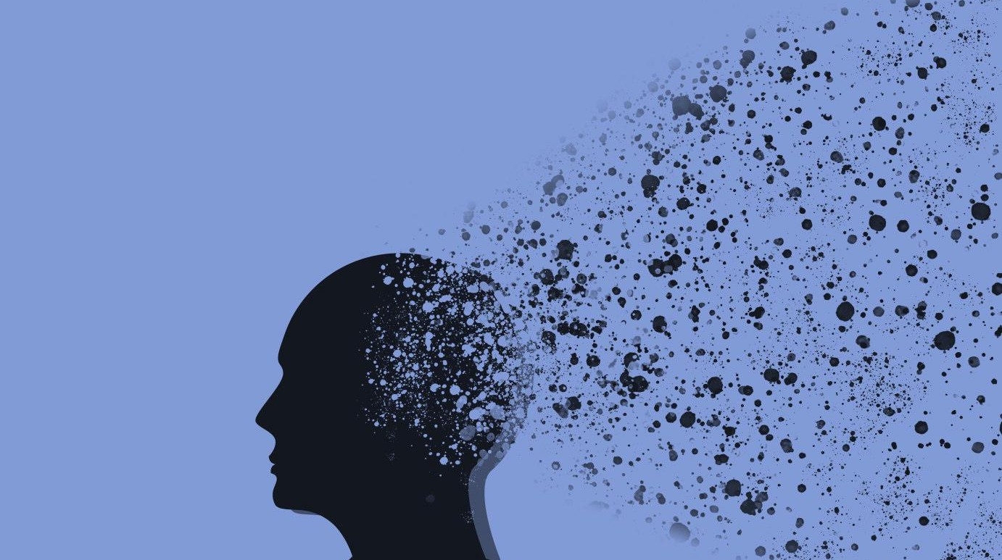




RESULTS COMPARISON
MODEL | ACCURACY | AUC | PRECISION | RECALL
Vgg19 | 0.84 | 0.97 | 0.87 | 0.80
DensNet- 121 | 0.82 | 0.96 | 0.86 | 0.75

Slide 24
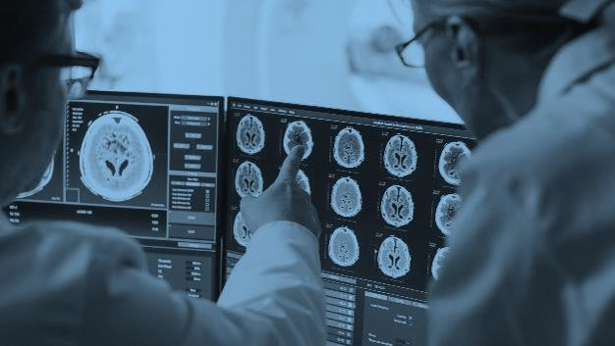

COMPARISON
OUR WORK | ANOTHER STUDY
VGG19: 84.0% Dataset: ADNI | CNN:72.7% VGG16:80.66% RESNET:76.86% Dataset: ADNI
26

Slide 25
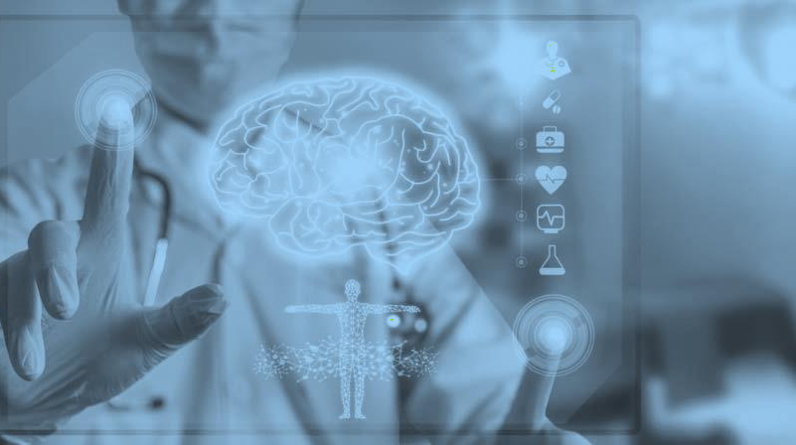
Thank You!

